Slide 1
OBLIQUE TRIANGLES

Slide 2
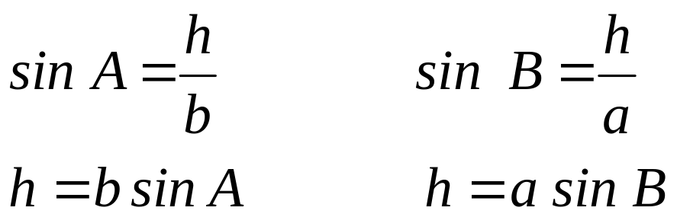
DERIVATION OF LAW OF SINES
Let ABC be an oblique triangle with sides a, b, and c opposite their respective angles as shown in the figure below. If an altitude h is drawn to the base, we can write the following relationship:
C
b
a
h
A
B
c

Slide 3
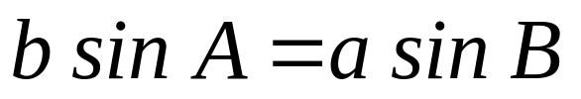
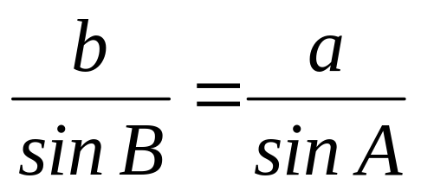
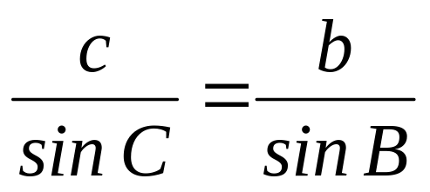
Equating the two expressions for h gives
Dividing both sides of the equation by sin A sin B gives the following relationship:
Similarly, if we draw an altitude from angle A to side a, we can derive the following expression:
Combining these two results gives the Law of Sines, summarized as follows.

Slide 4
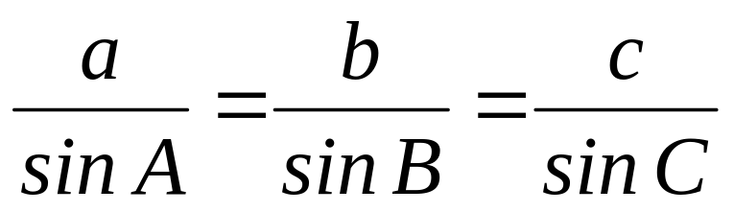
LAW OF SINES
For any triangle ABC in which a, b and c are the lengths of the sides opposite the angles with measures A, B, and C, respectively,
In words, the Law of Sines may be stated as follows: The sides of a triangle are proportional to the sines of the opposite angles.

Slide 5
Solution of oblique triangles involves four cases, namely:
Two angles and one side are given.
Two sides and the angle opposite one of the sides are given.
Two sides and the angle between those sides are given.
Three sides are given.
Note:
The Law of Sines is applicable for the first two cases and the Law of Cosines for the last two cases.

Slide 6
Case I: Two angles and one side are given.
Example: Solve the following triangles.
A = 51.3⁰ B = 48.7⁰ a = 24.5
A = 41⁰ B = 57⁰ c = 52
B = 119⁰ C = 21⁰ b = 59
Case II: Two sides and the angle opposite one of the sides are given. (AMBIGUOUS CASE)
When two sides and the angle opposite one of them are given, there may be no, one, or two solutions to the triangle. For this reason, Case II is called the ambiguous case. The following are the summary of the possible cases.

Slide 7
If A is an acute angle and a < b, there are three possibilities.
C
C
b sin A
b
b
a
a
a
b sin A
A
B’
B
A
C
Two solutions
a > b sin A
No solution
a < b sin A
b
a=b sin A
A
c
B
One solution
a = b sin A

Slide 8
2. If A is an acute angle and a ≥ b, then there is exactly one solution.
C
b
a
A
B
c
2. If A is an obtuse angle, then there are two possibilities.
C
C
a
a
b
b
A
B
A
c
No solution
a ≤ b
One solution
a > b

Slide 9
EXAMPLE:
Determine how many solutions exist. When either one or two solutions exist, solve the triangle or triangles.
A = 67⁰ a = 18 b = 20
A = 87⁰ a = 47 b = 50
A = 32⁰ a = 7 b = 10
A = 113⁰ a = 49 b = 54
A = 108.7⁰ a = 54.3 b = 51.2
Notes:
plane

Slide 10
Application:
Two forest ranger stations A and B are 48 miles apart. The bearing from A to B is N70⁰E. A ranger in each tower spots a fire. The fire’s bearing from A and B is N33⁰E and N14⁰W, respectively. Find the distance from the fire to each tower.
The Leaning Tower of Pisa was originally approximately 56 m high. If a surveyor trying to calculate the lean of the tower walks 72 m from the center base of the tower, the angle of elevation to the top is 40⁰. find the lean of the tower of Pisa.
On a hill inclined at an angle of 15.4⁰ with the horizontal, stands a tower. At a point Q, 61.5 m down the hill from the foot of the tower, the angle of elevation of the top of the tower is 42.6⁰. How tall is the tower?
Notes:
plane

Slide 11
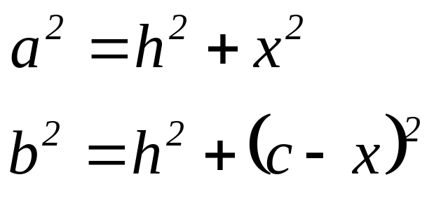
DERIVATION OF LAW OF COSINES
Let ABC be an oblique triangle with sides a, b, and c opposite their respective angles as shown in the figure below. The altitude h is drawn perpendicular to the base that divides side AB into two parts: x and x-c. Using the Pythagorean theorem for each triangle gives
C
b
a
h
c-x
x
A
B
c

Slide 12
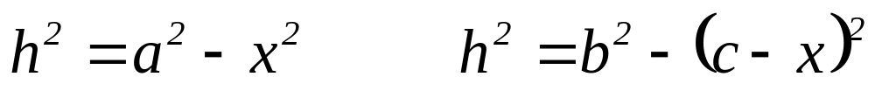
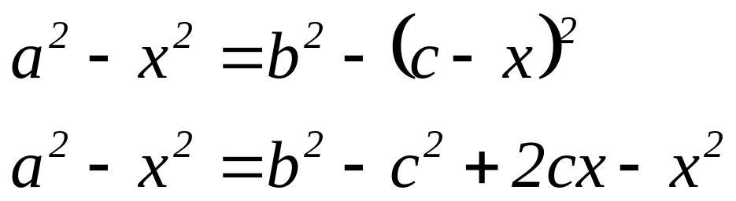
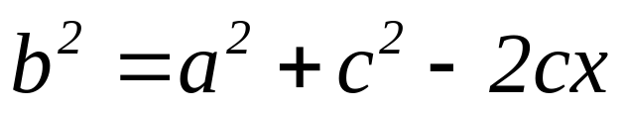
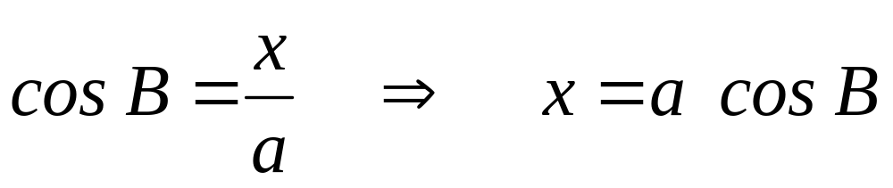
Solving each of these equations for h² gives
Equating the two expressions for h² gives
Solving the equation for b² gives
From the figure:

Slide 13
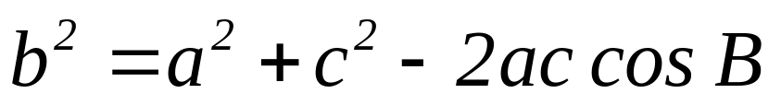
Substituting this expression for x gives one form of the Law of Cosines.
Using the same method and drawing altitudes to sides CB and AC gives similar results. The Law of Cosines is summarized as follows.

Slide 14
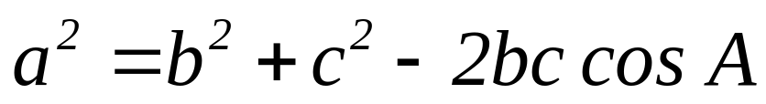
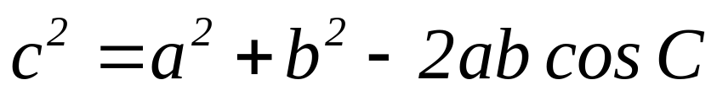
LAW OF COSINES
For any triangle ABC, where a, b, and c are the lengths of the sides opposite the angles with measure A, B and C respectively,

Slide 15
Case III: Two sides and the angle between those sides are given.
Example: Solve the following triangle.
a = 18.4 c = 26.3 B = 47.9⁰
C = 115⁰ a = 11 b = 21
A = 32⁰ b = 23 c = 47
Case IV: Three sides are given.
Example: Solve each triangle ABC.
a = 11 b = 14 c = 17
a = 23 b = 43 c = 31

Slide 16
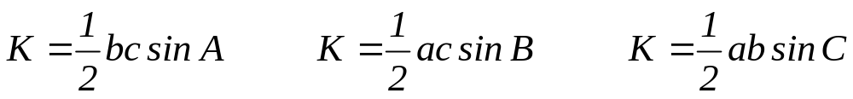
The Area of a Triangle
The area K of any triangle ABC is given by one of these formulas:
The above formulas are used to find the area of a triangle when the measures of the two sides and the included angle are known.

Slide 17
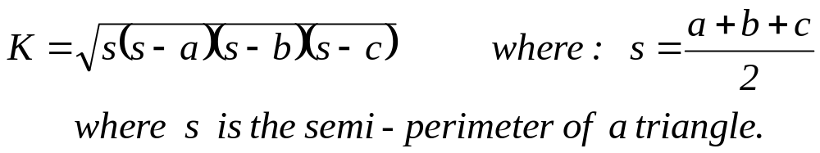
HERON’S FORMULA: If a, b, and c are the measures of the sides of a triangle, then the area K of the triangle is given by
Heron’s Formula is used to find the area of a triangle when three sides are given.
EXAMPLE: Find the area of the given triangle.
B = 71⁰ a = 21 c = 87
a = 31 b = 23 c = 14

Slide 18
Application:
An airplane flies from city A going west to city B, a distance of 275 miles, and turns through an angle of 43⁰ and flies to city C, a distance of 250 miles. Find the distance from city A to city C.
Two ships leave the same port at the same time. One ship sails on a course of 120⁰ at 16 knots while the other sails on a course of 220⁰ at 23 knots. Find after 3 hours (a) the distance between the ships and (b) the bearing from the first ship to the second.
A 75 ft vertical radio is to be erected on the side of a hill that makes an angle of 9⁰ with the horizontal. Find the length of two guy wires that will be anchored 80 ft uphill and downhill from the base of the tower.

